Slide 1
TOPIC A1:
COMPUTER FUNDAMENTALS
LESSON A1-5
LOGIC DIAGRAMS & TRUTH TABLES

Slide 2
AGENDA
Logic Gates
The seven operators
Truth tables – Circuits
Truth tables - descriptions
Boolean expressions and logic diagrams
Boolean algebra: simplifying
Karnaugh maps
WS A1-2: Diagram Double Down
WHAT U NEED 4 LESSON
Guided Notes
ur hedz

Slide 3
THE WARM UP QUESTION
Last lesson everything was a number written in binary.
(a) Convert 1010 0110 to decimal.
(b) Convert the same byte to hexadecimal.
(c) State how many different values one nibble can represent.
-> Notes Q1 (a)-(c) [3 marks] - do them now

Slide 4
THE WARM UP QUESTION
Last time, we looked at how to convert numbers to and from binary and hexadecimal
(a) Convert 1010 0110 to decimal.
(b) Convert the same byte to hexadecimal.
(c) State how many different values one nibble can represent.
-> Notes Q1 (a)-(c)

Slide 5
THE WARM UP ANSWER
(a) 128 + 32 + 4 + 2 = 166
(b) 1010 = A, 0110 = 6, so A6
(c) Four bits, 2^4 = 16

Slide 6
TWO STATES, NOW DECISIONS
Last time, we used 0 and 1 to store things, but this time, we’ll use them to decide things
Every conditional statement, like ifs and whiles, is a hardware question:
Given these inputs, is the answer 1 or 0?
A logic gate is a physical circuit that answers one of those questions.
Millions of them wired together are what make up the ALU

Slide 7
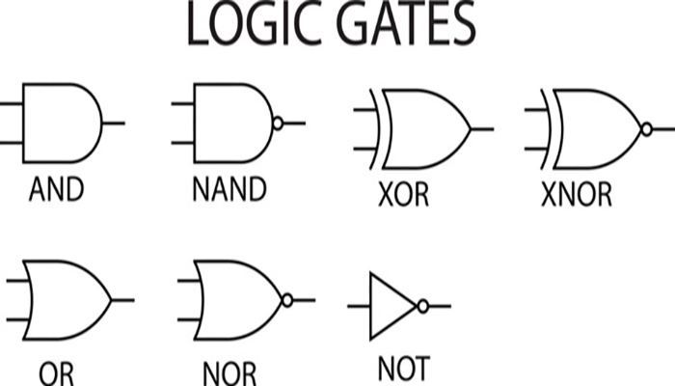
WHAT A GATE IS
One or two inputs, always one output
A Boolean operator is the check the gate applies.
A gate takes that check and makes it out of transistors
A truth table lists every possible combination of inputs and the output for each
Two inputs means four rows. Three inputs means eight, so on and so forth, 2^{n}
Before you fill a truth table out, make sure you have the right number of rows

Slide 8
AND, OR, NOT
AND - output 1 only when both inputs are 1
OR - output 1 when at least one input is 1
NOT - one input, outputs the opposite
Also called an inverter
A | NOT
0 | 1
1 | 0
A | B | A AND B | A OR B
0 | 0 | 0 | 0
0 | 1 | 0 | 1
1 | 0 | 0 | 1
1 | 1 | 1 | 1

Slide 9
NAND, NOR
NAND - AND with the output flipped. Output 0 only when both inputs are 1
NOR - OR with the output flipped. Output 1 only when both inputs are 0
The symbol is the AND or OR shape with a small circle on the output, the circle representing the inversion
Every other gate can be built out of NAND alone, which is why you may have heard of NAND before
A | B | A NAND B | A NOR B
0 | 0 | 1 | 1
0 | 1 | 1 | 0
1 | 0 | 1 | 0
1 | 1 | 0 | 0

Slide 10
XOR, XNOR
XOR - exclusive OR. Output 1 only when the inputs are different
XNOR - output 1 only when the inputs are the same. XOR inverted
XOR is a tricky one, so be sure to review that one especially
A | B | A XOR B | A XNOR B
0 | 0 | 0 | 1
0 | 1 | 1 | 0
1 | 0 | 1 | 0
1 | 1 | 0 | 1

Slide 11
THE SEVEN, ON YOUR NOTES
-> Notes Q2 [7 marks] - fill in all seven columns
If you can rebuild this table from scratch you should be pretty much clear for this part of the topic

Slide 12
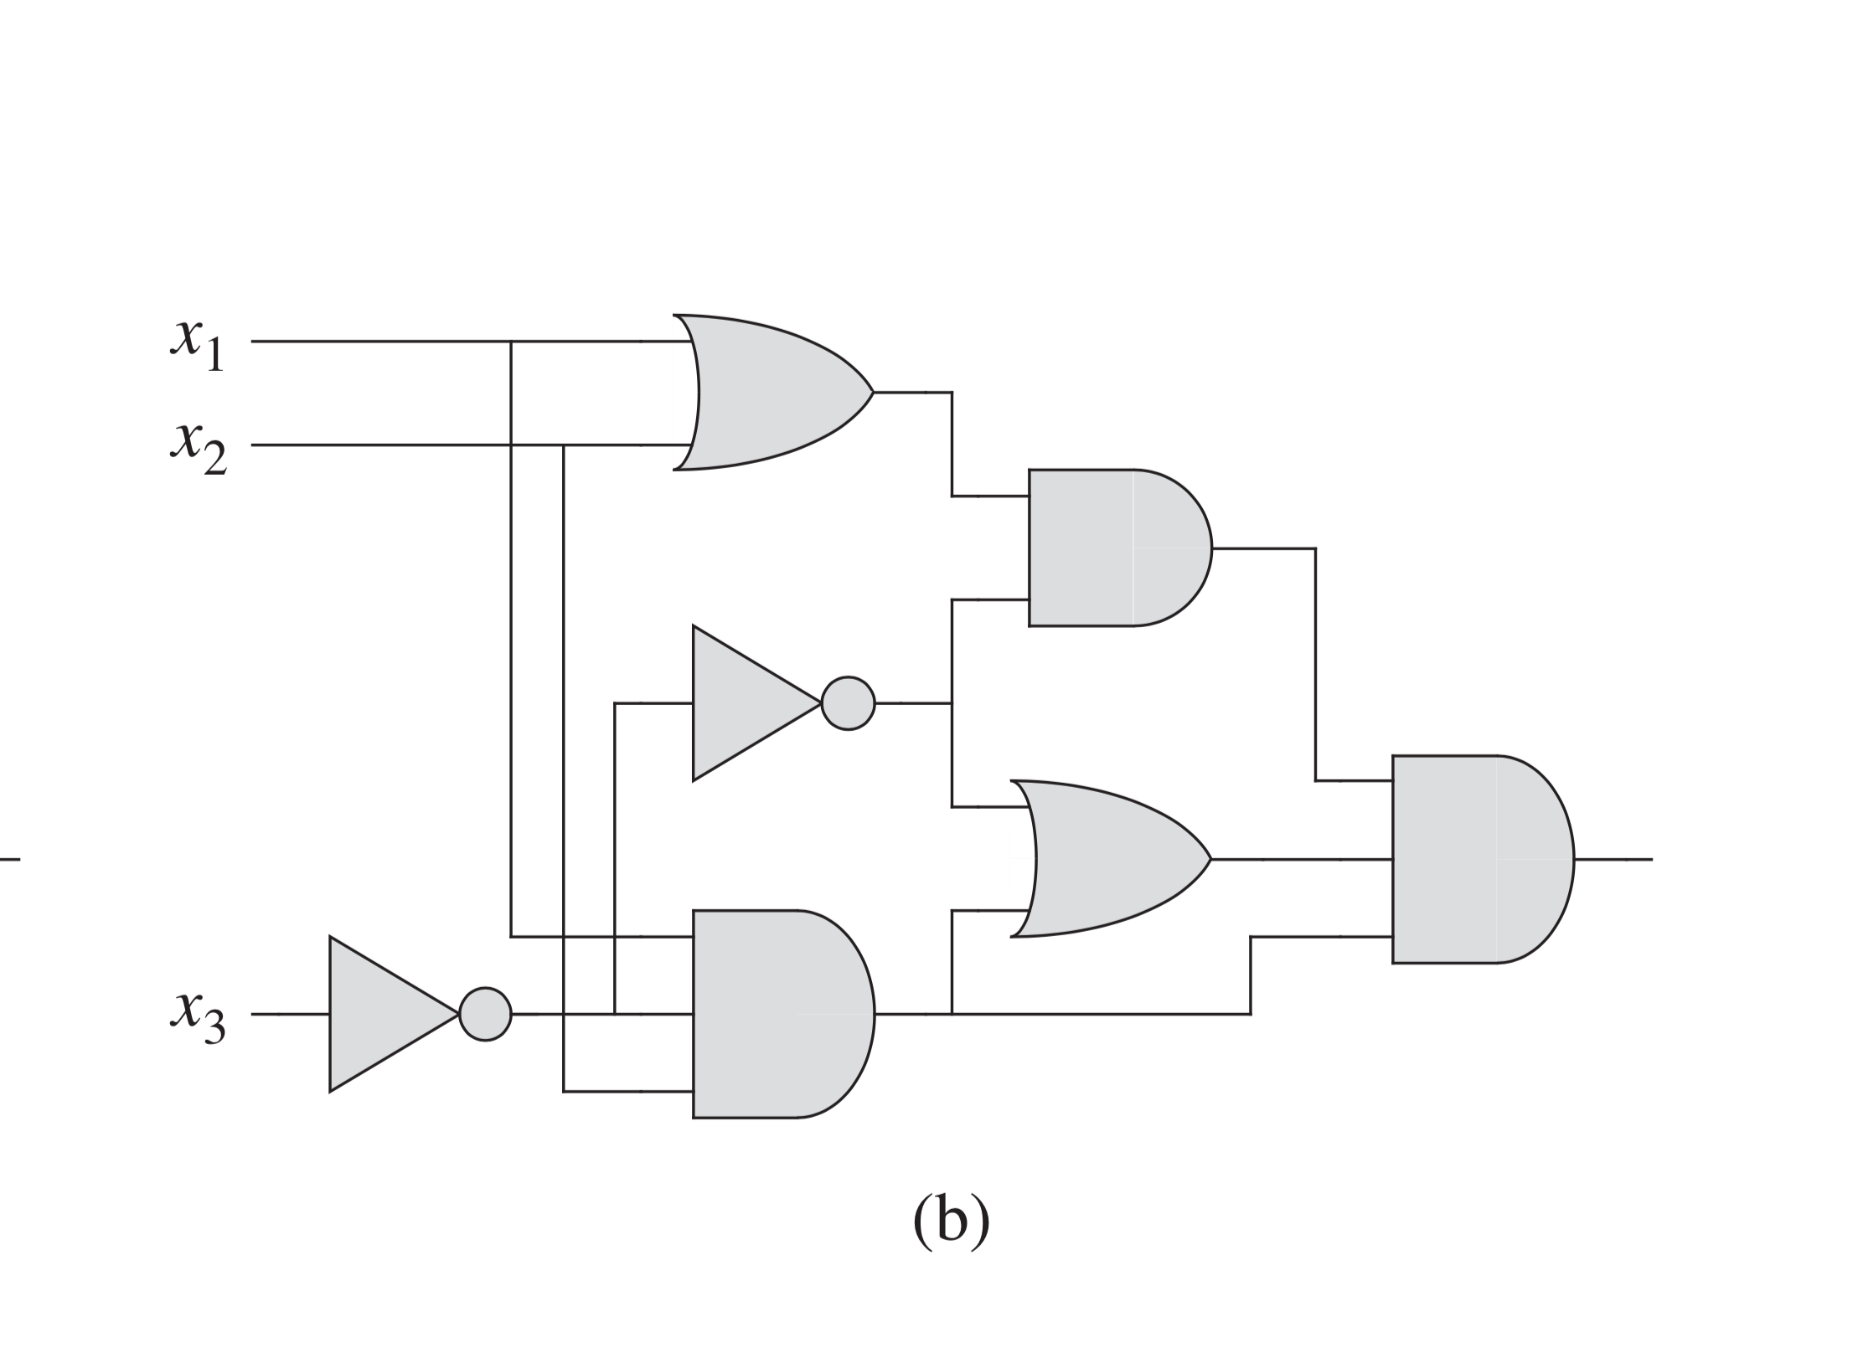
READING A CIRCUIT
A logic diagram is these gates wired together, with signals traveling from left to right
Solve gates with known inputs first, then use the results of those to determine future gates
When working through truth tables for logic diagrams, you should add intermediate columns for the middle work
The IB tends to mark you up for having intermediate columns

Slide 13
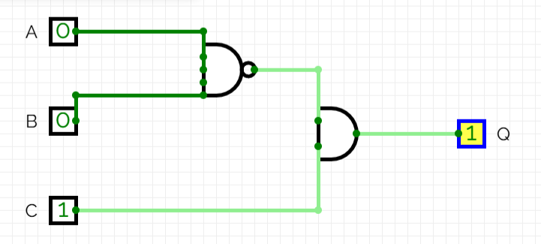
THE CIRCUIT ON YOUR NOTES
Let’s say we have three inputs. A and B go into a NAND gate. The output of those gates and C go into an AND gate, giving Q, the output
So the expression is Q = (A NAND B) AND C
The truth table should have eight rows, and two output columns: one for the NAND, one for Q.

Slide 14
THE CIRCUIT ON YOUR NOTES
A | B | C | A NAND B | Q
0 | 0 | 0
0 | 0 | 1
0 | 1 | 0
0 | 1 | 1
1 | 0 | 0
1 | 0 | 1
1 | 1 | 0
1 | 1 | 1

Slide 15
YOUR TURN
-> Notes Q3 [4 marks] - complete the eight-row table
Then, let’s check our answers together

Slide 16
FROM WORDS TO LOGIC
The exam usually describes a situation and asks you to build the logic yourself.
Three steps to do this:
Name each input with a letter and say what 1 means
Turn the sentence into an expression using and, or, not (and other gates if needed)
Build the table from the expression

Slide 17
THE FAN
A fan turns on when the temperature is high (T = 1) or the humidity is high (H = 1), but only when the system is switched on (S = 1).
Inputs: T, H, S. Output: F.
F = (T OR H) AND S
Make sure you’re paying attention to the logical order, that’s why we group the T and H, but the S is separate
It can be difficult to devise where these things should be split up

Slide 18
THE FAN TABLE
-> Notes Q4 (a)-(b)
Q4 (a) Write the Boolean expression for F. [1]
Q4 (b) Complete the eight-row truth table for F. [2]

Slide 19
EXPRESSIONS AND DIAGRAMS
A Boolean expression and a logic diagram both represent Boolean logic, just in two different forms
You are expected to know both for the exams
Brackets in the expression mean the logic gates must come first in the logic diagram
Each operator is one gate, a one to one relationship

Slide 20
DRAWING ONE
Q = (A AND B) OR (NOT C)
Three operators, so three gates:
A and B into an AND gate
C into a NOT gate
both of those outputs into an OR gate, giving Q
Use paper or an expo marker, and get a picture

Slide 21
DIAGRAMS ON YOUR NOTES
-> Notes Q5 (a)-(c)
Q5 (a) Draw the logic diagram for Q = (A AND B) OR (NOT C). [2]
Q5 (b) Write the Boolean expression for the circuit in Q3. [1]
Q5 (c) State the difference between the standard symbols for AND and NAND. [1]

Slide 22
BOOLEAN ALGEBRA
Gates cost money, power and space, so a circuit that does the same job with fewer gates is a better circuit. Boolean algebra is how you find it.
Here are some ways to simplify logic expressions
A AND A = A A OR A = A
A AND 1 = A A OR 0 = A
A AND 0 = 0 A OR 1 = 1
A AND NOT A = 0 A OR NOT A = 1
NOT(NOT A) = A
De Morgan's laws: NOT(A AND B) = NOT A OR NOT B

Slide 23
SIMPLIFYING, WORKED
Q = (A AND B) OR (A AND NOT B)
B is 1 in the first term and 0 in the second, so between them they cover every value of B.
B cannot change the answer at all. Q = A.
So, we’ve gone from three gates to literally none
You can always check a simplification using a truth table
A | B | NOT B | A AND NOT B | A AND B | Q
0 | 0 | 1 | 0 | 0 | 0
0 | 1 | 1 | 0 | 0 | 0
1 | 0 | 1 | 1 | 0 | 1
1 | 1 | 0 | 0 | 1 | 1

Slide 24
SIMPLIFYING ON YOUR NOTES
-> Notes Q6 (a)-(d)
Q6 (a) Simplify A AND (A OR B). [1]
Q6 (b) Simplify (A AND B) OR (A AND NOT B). [1]
Q6 (c) Simplify NOT(NOT A). [1]
Q6 (d) A circuit computes (A OR B) AND (A OR B). State how many gates can be removed, and why. [1]

Slide 25
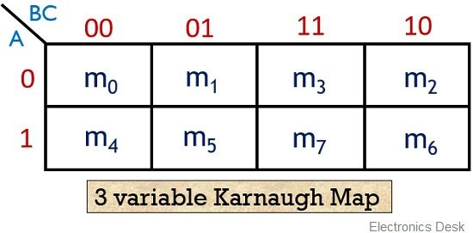
KARNAUGH MAPS
Algebra works, but only if you spot how to simplify it
A Karnaugh map finds the same answer visually
It is the truth table redrawn as a grid, with the columns in the order 00, 01, 11, 10
Neighboring cells differ by exactly one bit, so anything you can group is something that bit cannot affect
A\BC | 00 | 01 | 11 | 10
0
1

Slide 26
GROUPING
Copy each 1 from the truth table into its cell, then circle groups of 1s.
Groups must be rectangles of 1, 2, 4 or 8 cells
Bigger groups are better. Groups may overlap, and the edges can wrap around
Read each group by keeping the variables that stay the same and dropping the ones that change
A | B | C | Q
0 | 0 | 0 | 0
0 | 0 | 1 | 0
0 | 1 | 0 | 1
0 | 1 | 1 | 1
1 | 0 | 0 | 0
1 | 0 | 1 | 0
1 | 1 | 0 | 1
1 | 1 | 1 | 1
A\BC | 00 | 01 | 11 | 10
0 | 0 | 0 | 1 | 1
1 | 0 | 0 | 1 | 1

Slide 27
GROUPING
Hmmm… y’know what…. it kind looks like only the value of B matters here, doesn’t it?
A | B | C | Q
0 | 0 | 0 | 0
0 | 0 | 1 | 0
0 | 1 | 0 | 1
0 | 1 | 1 | 1
1 | 0 | 0 | 0
1 | 0 | 1 | 0
1 | 1 | 0 | 1
1 | 1 | 1 | 1
A\BC | 00 | 01 | 11 | 10
0 | 0 | 0 | 1 | 1
1 | 0 | 0 | 1 | 1

Slide 28
K-MAPS ON YOUR NOTES
-> Notes Q7 (a)-(c) [4 marks] - do them now
Q7 (a) Complete the Karnaugh map from the truth table given. [2]
Q7 (b) Circle the largest group and write the simplified expression. [1]
Q7 (c) State one advantage of a Karnaugh map over algebraic simplification. [1]

Slide 29
LAB
-> Notes Q8, Q9 and Q10
Q8 State the Boolean operator that outputs 1 only when its two inputs are different. [1]
Q9 Construct a truth table for Q = NOT A OR (B AND C). [3]
Q10 A door opens when a valid card is presented (C = 1) and either the manager is present (M = 1) or it is within opening hours (H = 1). Write the expression and draw the diagram. [4]

Slide 30
LAB ANSWERS
Q8 XOR
Q9 Q = 1 1 1 1 0 0 0 1 reading down from A=0,B=0,C=0. Only the three rows where A is 1 and B AND C is 0 give 0
Q10 D = C AND (M OR H). One OR gate taking M and H, its output and C into an AND gate. Brackets, or the door opens on the manager alone

Slide 31
WS A1-2: DIAGRAM DOUBLE DOWN
Five sections: name the gate, build tables, draw diagrams, simplify, and one Karnaugh map.

Slide 32
VOCABULARY TO REMEMBER
Logic gate
Boolean operator
Truth table
Logic diagram
Boolean expression
AND / OR / NOT
NAND / NOR
XOR / XNOR
Inverter
Boolean algebra
De Morgan's laws
Karnaugh map
Grouping
Redundant gate

